Slide 1

CLM in COVID 19 out break: gains and challenges
Martin p. ellie
4th june, 2021

Slide 2
Presentation Outline
Strategic focus of intervention
Data collection process
Results from data analysis
Feedback from stakeholder meeting
Advocacy Roadmap
Advocacy wins
Challenges

Slide 3
Strategic Focus
Strategic focus/Objectives
To provide adherence support to Recipients of Care in Western Area, Sierra Leone
To implement a scaled-down community treatment observatory that cover health facilities in the western Area of Sierra Leone
To mitigate the impact of COVID-19
Coverage and Target
Western Area – Urban and Rural districts
Five health facilities for data collection ( Urban-Connaught Hospital, PCMH, Ola During Children’s Hospital, Rural - Waterloo CHC, Tombo CHC)
Recipients of Care in 48 Community ART Groups – for adherence support

Slide 4
Data Collection Process
Quantitative Data
ITPC tool used by volunteers to collect data from service registers at health facilities
Data collected on monthly basis for 4 months – September- December 2020
Qualitative data
ITPC tools used by volunteers to collect data or conduct interviews for RoC and HCW
Recordings are captured with tablets
Key points are captured in the worksheet and also transcribed in word
DQA/Quality Assurance
Focal Point receives and reviews field report
Project officer conducts follow up visit to health facility to address issues with data
Focal point organizes review meeting with project team and HCW every two months to verify correctness of data
Notes:
1.Both quantitative and qualitative data were collected at the five facilities with tools developed by ITPC for four months (Sept – Dec)
2. Data collection was done by four volunteers supervised by a Project Officer
3.Both quantitative and qualitative data were collected, verified and uploaded into the ITPC platform

Slide 5
Data analysis for period September –December 2020
‘Our clients are afraid to come because their immunity is already compromised. They fear getting COVID-19’
HCW Connaught, 7th Dec. 2020
Notes:
1.The charts present aggregated data for quantitative data collected from health facility records
2. All the facilities initiate treatment ‘some other day’ (Amber) than the very day client test positive to HIV . PCMH and Tombo are exceptional
3. Lost to follow up (dark grey) is a concern in almost all the facilities especially PCMH

Slide 6
Data analysis for period September –December 2020
Notes:
Viral load test is a concern over the last four months due to breakdown of the equipment
Specimen taken cannot be tested for PCMH and ODCH (Green bars) and we cannot ascertain viral suppression
Treatment failure (light grey) is not captured in the service registers and cannot be reliably reported
TB testing service is offered for both co-infected and for people referred for testing

Slide 7
Data analysis for period September –December 2020
‘The health care workers are always hospitable. They talk and encourage us to adhere to our treatment’ (RoC, Tombo- 10th October 2020)
My leadership structure is well positioned to improve client access to the facility (HCW Waterloo, 10th October 2020
Notes:
Connaught and PCMH offered more MMD – two and three months (4125 and 4107) for the intervention period respectively

Slide 8
Achievements for Adherence support for period September –December 2020
Service Area | Total number reached
Recipients of care (RoC) reached with adherence support | 312
Recipients of care ART defaulting clients brought to care | 35
Exposed children followed up for EID | 15
Community ART Groups reached | 48 (Rural 15, Urban28)

Slide 9
Data analysis for period September –December 2020
TB Test at Health Facilities
Stock out of Medication and Equipment
Facility | Type | Count
Connaught | Smear Microscopy | 372
ODCH | Rapid Molecular test (GeneXpert) | 27
PCMH | 0 | 82
Waterloo CHC | Smear Microscopy | 136
Tombo CHC | Smear Microscopy | 149
Facility | Medicine | Duration | Equipment | Duration
Connaught | TLE | 30 | Viral Load Machine | 3 months
ODCH | Lopinavir/Ritonavir 100/25mg | 14 | Viral Load Machine | 3months
 | Lopinavir/Ritonavir 200/50mg | 14
PCMH | 0 | 0 | Viral Load Machine | 3months
Waterloo CHC | Tenofovir/Lamuvudine | 30 | Viral Load Machine | 3 months
Tombo CHC | 0 | 0 | Viral Load Machine | 3 months

Slide 10
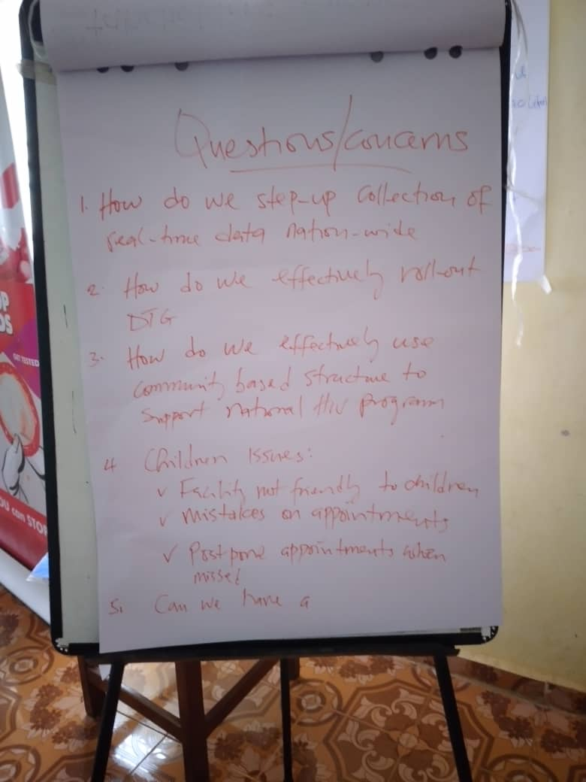
Feedback from Key stakeholder meeting
Need to step up collection of real-time data nationwide
Need to effectively rollout DTG in Sierra Leone
Need to effectively use community based structures to support national HIV program
  Address the following children issues
                Facility not friendly to children
      Mistakes on appointments
    Appointments are postponed when missed
Need for national strategy to fully address stock-out

Slide 11
Advocacy roadmap
Advocacy Issues
Repair or replace viral load machine
Capture treatment failure in service registers
Address stock-out at health facilities
Improve pediatric care
Address factors leading to Lost to follow up
What to do
Engage key partners to repair/replace viral load machine
Engage NACP to capture treatment failure in service registers
Adopt a national strategy that addresses stock –out
Effective roll-out DSD and adopt task shifting at health facilities
Desired change
Viral load machine repaired or replaced
Treatment failure captured in service registers
National strategy or pathway adopted to address stockout
DSD rolled-out to address lost to follow up issues

Slide 12
Advocacy Wins
Viral load machine has been fixed and will commence operation soon
Received commitment from NACP to include treatment failure as indicator when national tools are reviewed
At the start of COVID 19, there were fears of an extra 500,00 deaths due to obstruction to HIV services. It is time for advocacy organizations to focus on emergency preparedness

Slide 13
Challenges
Livelihood- Some RoC were challenged with food to eat and transport fare to health facility for ART refill
Health Records-Service Registers do not capture treatment failure, making it difficult to reliably track data on the indicator
Stock out of medication at health facilities
Fear of stigmatization - It was noted that RoC particularly women living with HIV fear stigmatization if their sero- status was discovered.
Breakdown of viral load machine for over four months months

Slide 14

End of Presentation

