Slide 1
Overview of CLM in C19RM
4 June 2021

Slide 2
The Problem & Opportunity
  As the COVID-19 pandemic continues to challenge, and in some cases overwhelm health services, we must urgently take action to understand the impact on people living with and impacted by HIV, TB, and malaria, and work to make adjustments in real-time to ensure ongoing access to, and uptake of prevention, treatment, care and support services.
  With dedicated and deliberate investment in CLM for C19, we have an opportunity for data and evidence generated through CLM on COVID-related impacts on HTM services to support national responses to the pandemic and minimize disruptions of health services for those affected by the three diseases.
  Without CLM, HTM programs will be severely hampered; with it, HTM programs can succeed, even in the unpredictable context of COVID-19.
  CLM reveals the importance of community pandemic preparedness and reinforces how empowered communities can play a pivotal role in supporting the continuity of quality services by holding policy makers accountable.

Slide 3
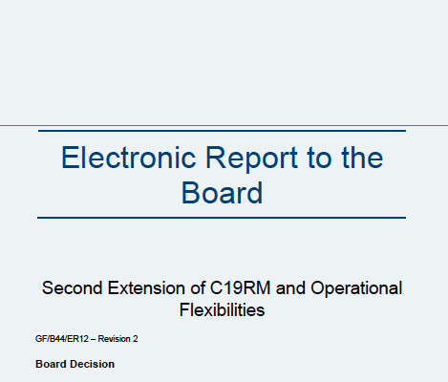
CLM is embedded in the C19RM rationale and strategy
According to the Board’s C19RM 2.0 Decision, CLM is needed:
  To inform C19RM allocations: “Data inputs used to inform the adjustments will include […] data from community-led monitoring (CLM)” (pg. 15)
  To address community engagement challenges: “The Secretariat will provide support through […] a portion of the centrally managed C19RM funds for broader CRG areas, e.g. community-led monitoring” (pg. 26)
  To ensure the success of country-level C19RM investments: “Some examples of such needs include: […] support for global coordination on community-led monitoring (including for reporting on human rights violations and GBV and to address quantitative and qualitative data gaps on HIV, TB and malaria services” (pg. 29)
  To ensure synergies with 6th replenishment grants: “Additional strategic priority areas [for centrally managed C19RM funds ] […] may include support for coordination on community-led monitoring” (pg. 60)
Board Decision Paper: value of CLM to C19RM investments for rapid feedback, centrally managed funds can be allocated to CLM for Covid-19, CLM contributes to the success of not only HTM grants, but now evident in C19 towards equitable access to control and containment, vaccine preparedness and access

Slide 4
CLM is a core component of funded activities under C19RM
CLM data can inform multiple pillars of C19RM grants: such as indicating if there are stockouts or limited supply of tests, drugs, vaccines, supplies, commodities, etc.; whether COVID-19 measures are in place; if key or specific populations are being turned away from services; and what messages need to be disseminated to communities. In addition, the Global Fund’s COVID Information Note from April 2021 mentions:
Section | CLM mention
COVID-19 Control and Containment | Pillar 1: Support to civil society and community organizations in order to play a meaningful part in country- level co-ordination Pillar 2: a) Identify and map marginalized and at-risk populations to engage with culturally appropriate messages using relevant channels and community networks/influencers. b) Establish mechanisms to embed the voice of communities into decision-making for emergency response
Mitigation for Disease Programs | Pillar 9: Community response: Support the development, adaptation and delivery of additional services through CBOs and expansion of CLM
Health and Community System Strengthening, Respond to human rights and gender related barriers to services: | Scaling-up support for community-led monitoring (CLM) of human rights violations and equitable distribution and access of C19RM funded tools – be it through expanding existent systems and apps or instituting harmonized paper-based/e-mail based quick reporting forms. CLM may need to be expanded in scope, to capture access to PPE, non-discriminatory food support, etc.
“Understanding communities and adapting to reflect those insights will look different for every community.”
–Global Fund COVID-19 Response Mechanism Information Note, 8 April 2021

Slide 5
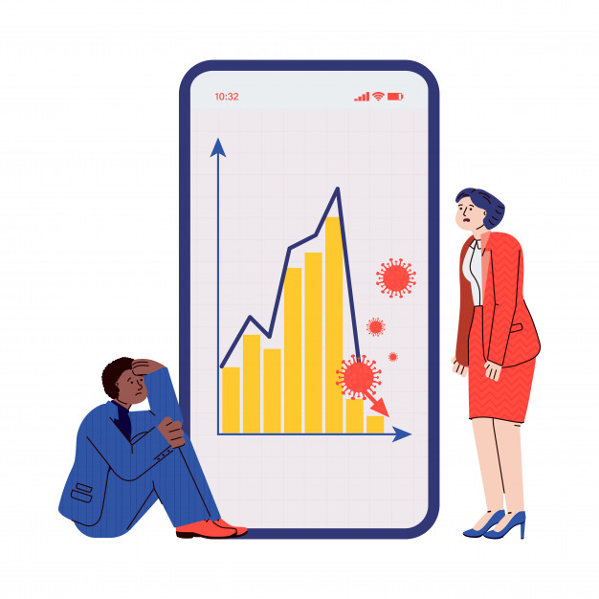


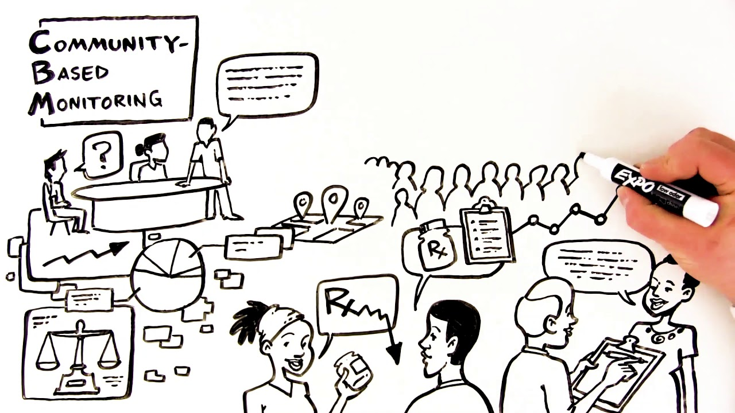
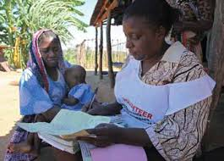
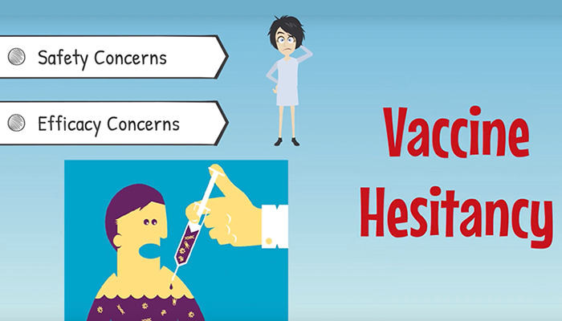
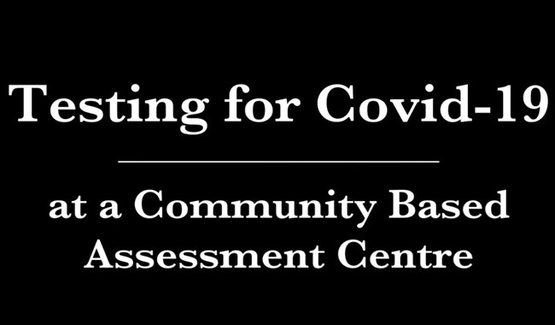
Community-led-activities
Diversion of human resources for health
Diversion of financial resources
Communities are well placed to monitor, alert, provide guidance and services
Adapting HTM service delivery
Addressing vaccine hesitancy

Slide 6
Community-led-activities
Survey results are showing that both human and financial resources have been diverted from government diseases programs to the fight against COVID-19. Communities are needed more than ever and are well placed to alert, provide guidance and services.
Finance CBOs to monitor the impact of COVID-19 on health service providers in their communities
Finance community-based education and advocacy to overcome vaccine hesitancy
Support communities to monitor and report on quality of services, stock-outs, and human rights violations
Finance the development of advocacy materials on the importance of preserving access to HIV, TB and malaria services and reproductive health services
Strengthen existing community platforms (drop-in centres, safe spaces, community-based clinics) as well as community networks to deliver services (related to GBV/IPV, HIV, TB, malaria, and COVID-19.)
Expand the provision of community-led HIV or malaria rapid testing to COVID-19 (and future vaccines and therapeutics)
Sensitize COVID-19 health care workers on issues of stigma, discrimination and unconscious bias against KVPs and people living with HIV (PLHIV) and the need to provide care to these groups in a non-stigmatizing, non-discriminatory manner
Support engagement with community leaders and raise awareness on the potential rights violations in the context of COVID-19 against KVPs

Slide 7
Community-led monitoring must be embedded in C19RM grants to make them effective
  The Information Note says funding requests can include CLM activities such as:
  Development, support and strengthening of community-based mechanisms that monitor: availability, accessibility, acceptability and quality of services (e.g. observatories, alert systems, scorecards); health policy, budget and resource tracking, and monitoring of health financing allocation decisions; and/or complaint and grievance mechanisms;
  Community-led and/or -based monitoring of barriers to accessing services (e.g. human rights violations, including stigma and discrimination and confidentiality; age and gender-based inequities; geographical and other barriers) for purposes of emergency response, redress, research and/or advocacy to improve programs and policies;
  Tools and equipment for community-led and/or -based monitoring (including appropriate technologies);
  Technical support and training on community-based monitoring: collection, collation, cleaning and analysis of data; and using community data to inform programmatic decision making and advocacy for social accountability and policy development; and
  Community engagement and representation in relevant governance and oversight mechanisms;
  CBO monitoring of the impact of COVID-19 on health service providers in their communities;
  Support communities to monitor and report stock-outs, quality of services and human rights violations.
Intel from civil society confirmed that C19RM Funding Requests include CLM activities.
“These proposed activities will therefore support CBOs through community monitors to monitor the impact of COVID-19 in their communities, including who is being excluded from services” – Botswana’s May 2020 C19RM funding request

Slide 8

Thank You

Slide 9
Backup

Slide 10
Technical guidance and templates
Streamlining content and developing strong technical guidance.
C19RM Technical Information Note
HIV, TB & Malaria Information Note: Mitigation of COVID-19 Effects on HIV, TB & Malaria Services & Programs
Technical Information Note on Community Systems & Responses: to improve community engagement
Guidelines for
Grant Budgeting
Provides applicants with technical guidance on eligible C19RM interventions, based on WHO COVID-19 Response Pillar Framework
Emphasis on community-led responses
Supports CCMs, national programs for HIV, TB & malaria, & in-country partners with C19RM funding request development
In addition to the interventions covered in the guidance, examples of CRG-related investments during COVID-19.
WHO Strategic Preparedness
& Response Plan
for COVID-19
Notes:
1. there is the CRG info note which provides a list of eligible intervventions including CSS (and CLM)
2. And in yellow, some examples of interventions related to CLM (and or CSS)

Slide 11
Community Systems and Responses more visible
6 “CRG” interventions covered in the guidance (out of 18 in total):
Community-led monitoring
Community-led advocacy and research
Social mobilization, building community linkages and coordination
Institutional capacity building, planning and leadership development
Gender-based violence (GBV) prevention and care
Respond to human rights and gender related barriers to services
Regular CSS interventions
!
Note: Community-led responses should be included across the other interventions (or pillars) of C19RM; for example, community-led organizations could be engaged in contact tracing of COVID-19 patients, testing, etc.

Slide 12
2.1 Context
Section 2: C19RM Full Funding Request (CRG)
    2.1.2: Summarize which stakeholders have been engaged in the development and decision-making for this Funding Request, including the national HIV, TB and malaria programs, central medical stores (or equivalent), laboratory systems, civil society and key and vulnerable populations (including both CCM members and non-CCM community representatives), and communities most severely affected by COVID-19.
2.3 Funding request & prioritization
2.3.4: Impact of COVID-19 on gender-based violence and human rights
2.3.5: Prioritization of interventions & activities
Provide a brief overview of which considerations guided the prioritization process.
ACTIVITIES WHICH RESPOND TO THE SITUATION DESCRIBED HERE
2.3.1: Provide information on disruption of HIV services
2.3.2: Provide information on disruption of TB services
2.3.3: Provide information on disruption of malaria services
particularly for key and
vulnerable populations
2.4 Implementation arrangements
2.4.2: Community-based Organizations & Implementation Arrangements
Describe the role CBOs will play in the response
Indicate whether there are opportunities to reinforce the role and effectiveness of CBOs in the national COVID-19 response, including through supporting the most vulnerable communities, community tracing, supported isolation and addressing vaccine hesitancy

Slide 13
